Slide 1
Attitudes to adaptation
Survey and message testing
October 2025
[Put deck into slideshow mode to read all graphs]

Slide 2
Research questions
What climate adaptation policies carry the most risk of unpopularity, and which are the most popular?
Are there any adaptation narratives that help build climate salience with voters? If not, which ones at least inoculate best from backlash?
Are other words than ‘adaptation’ better for describing this agenda?
Methodology
x1 survey of 3,000 voters via YouGov, including a MaxDiff experiment
X1 Randomised Control Trial (RCT) message test

Slide 3
Survey of 3,000 voters via YouGov, including a MaxDiff experiment

Slide 4
On the basics
Most voters understand the threat of climate change - and feel the UK is poorly placed to deal with it

Slide 5
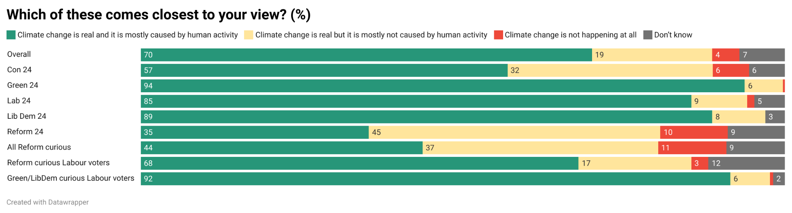

Slide 6
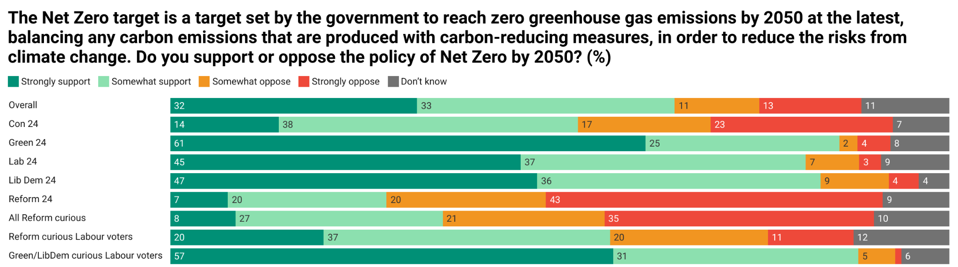

Slide 7
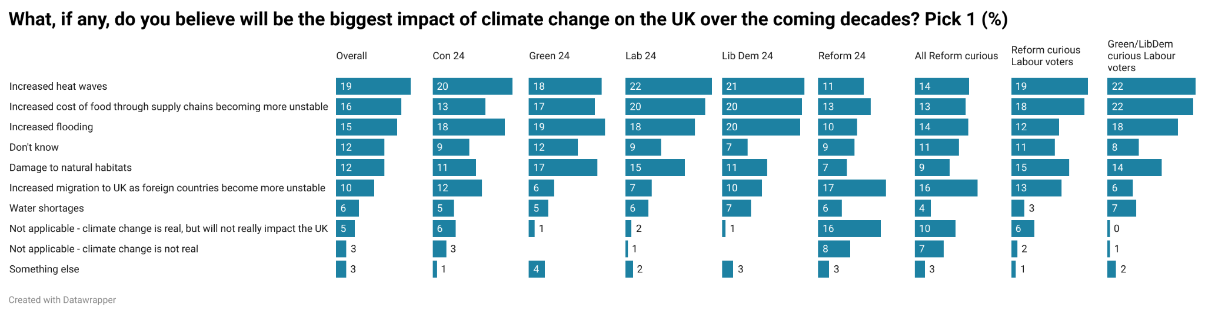

Slide 8
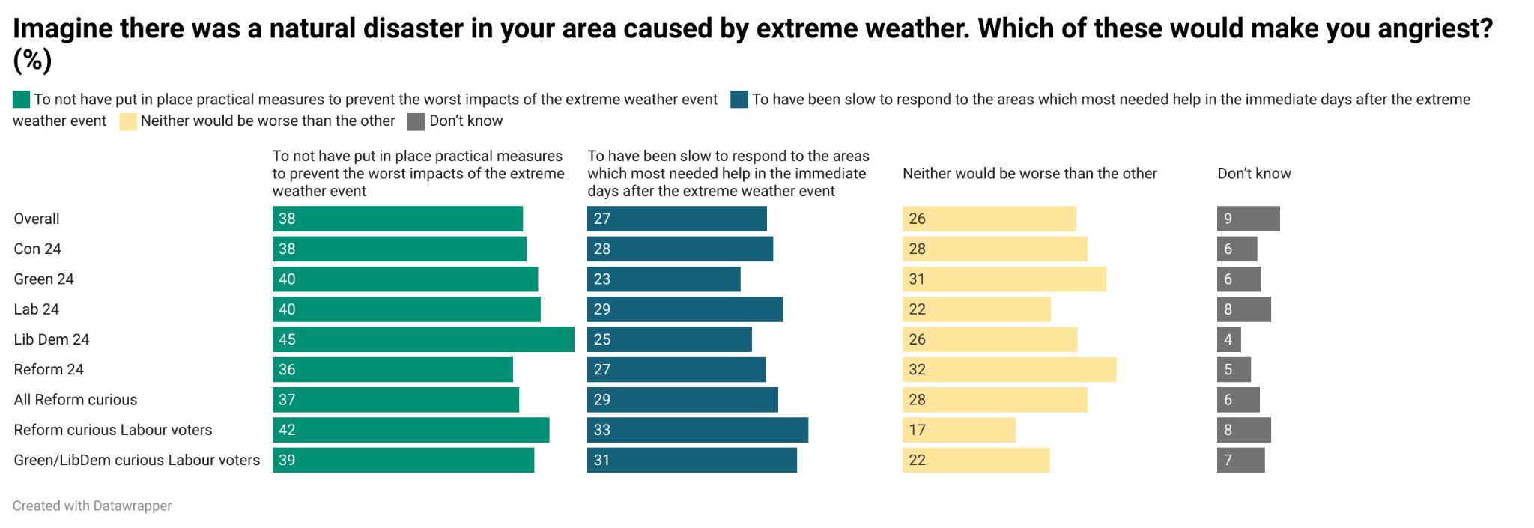

Slide 9
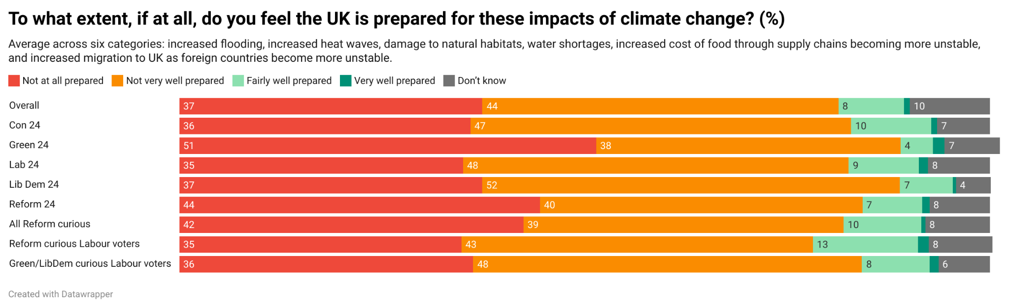

Slide 10
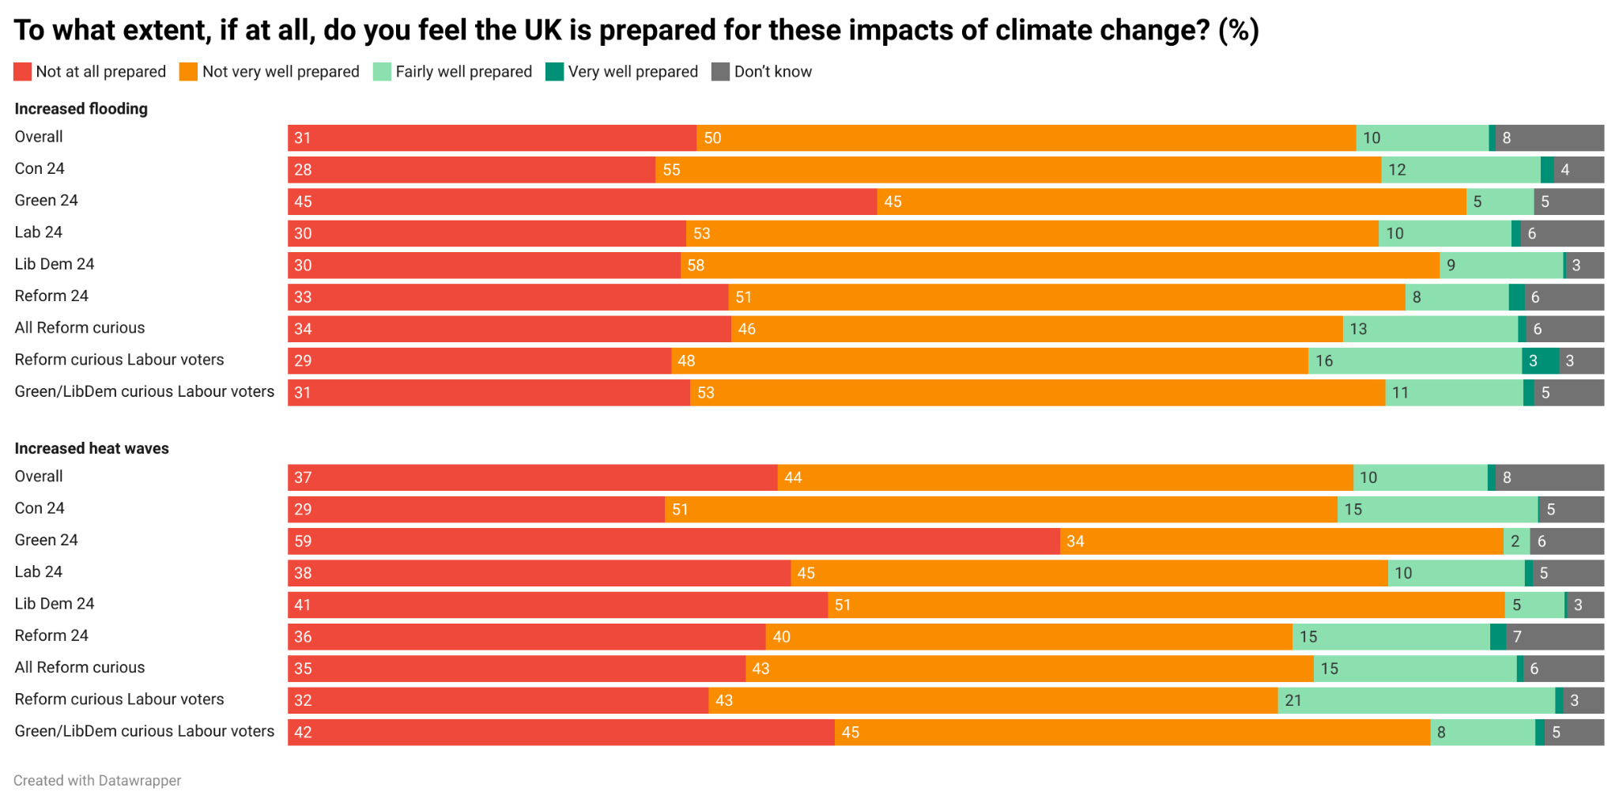

Slide 11
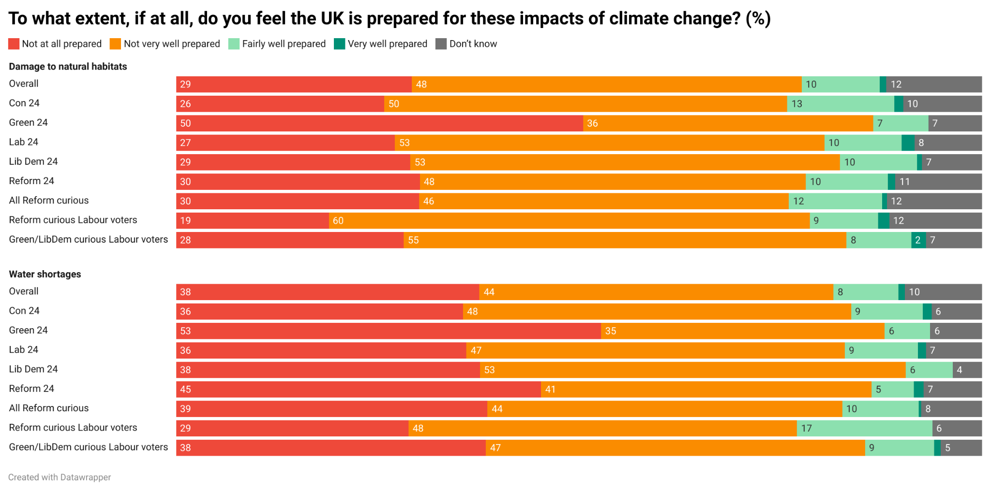

Slide 12
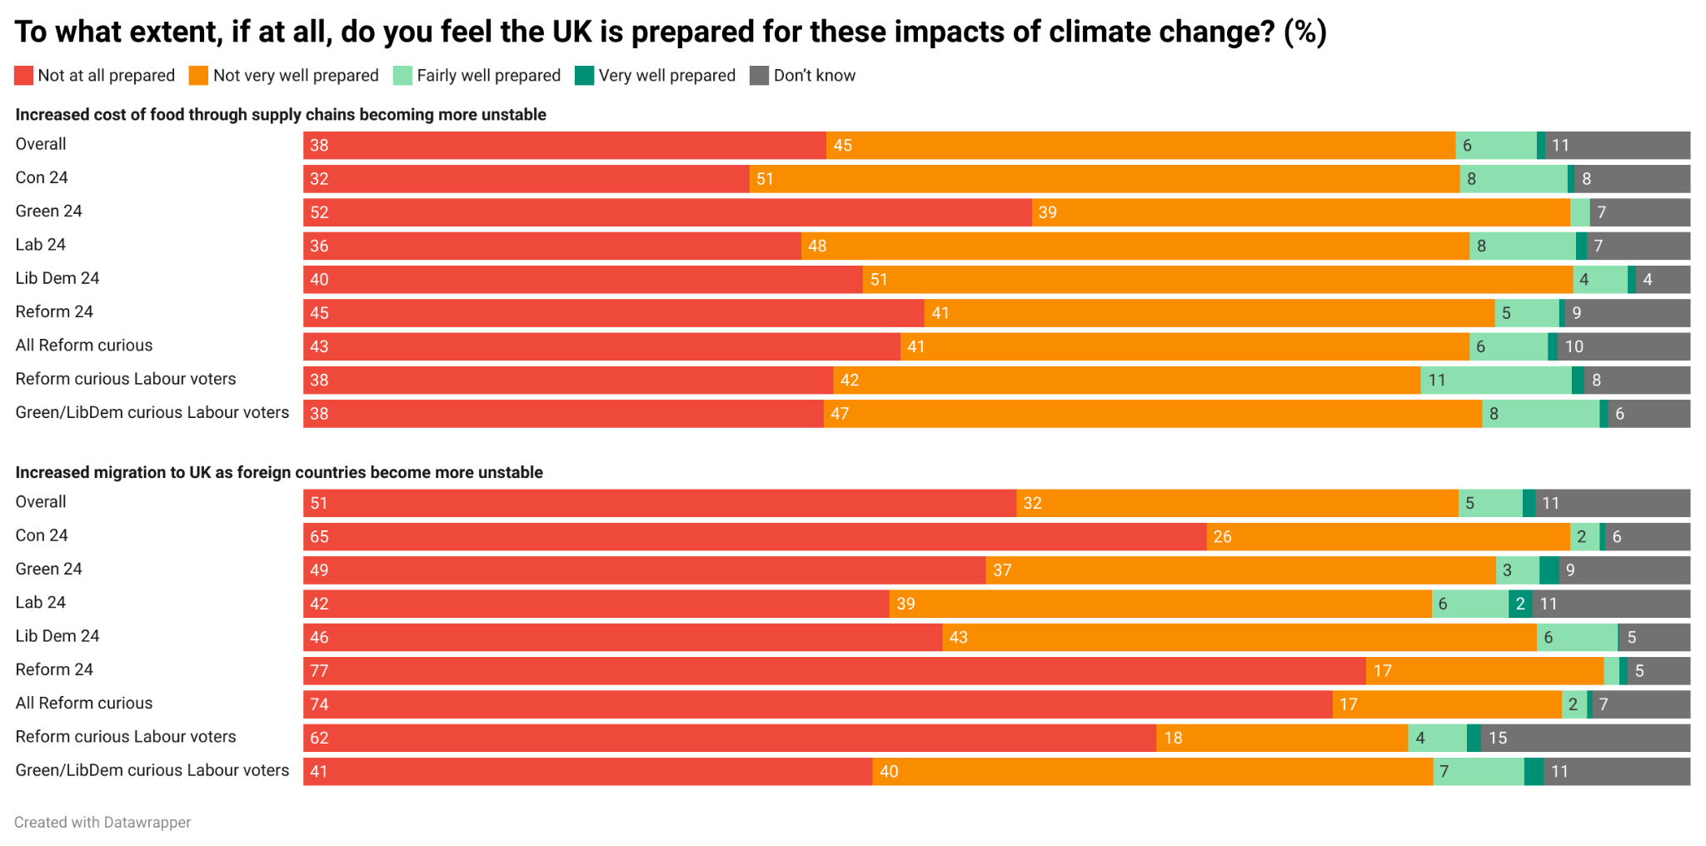

Slide 13
On the adaptation vs mitigation divide
However, most people - including Lab/Reform swing voters - do not instinctively buy the trade-off between adaptation and mitigation. They want both.
The view that the UK government is doing too much emissions reduction and not enough adaptation is also held by no more than 27% of the population.
This is another area where a small, vocal and highly online minority of core Reform voters has been allowed to distort perceptions of public opinion.

Slide 14
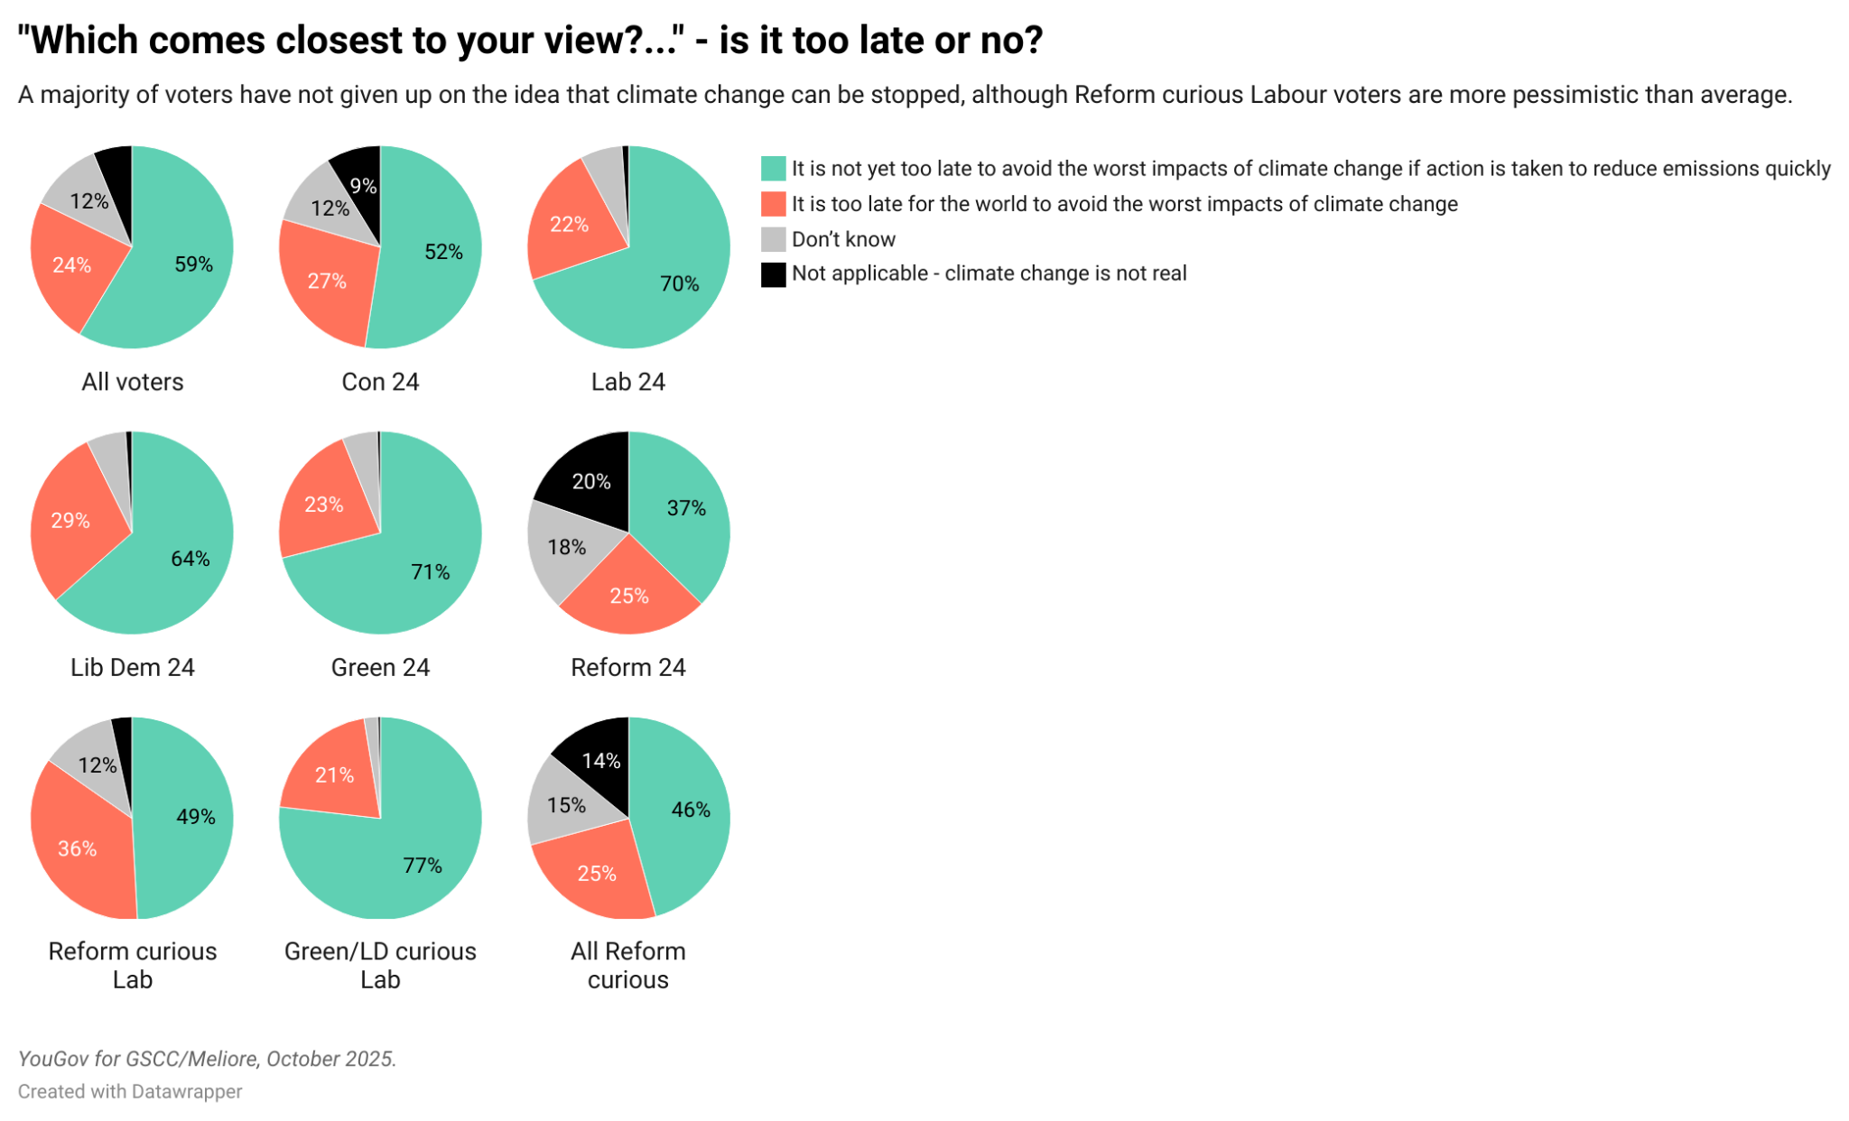

Slide 15
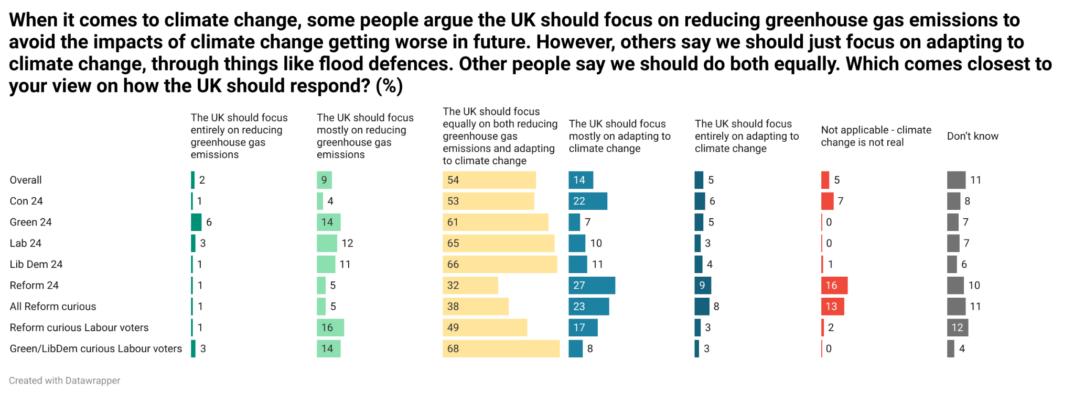

Slide 16
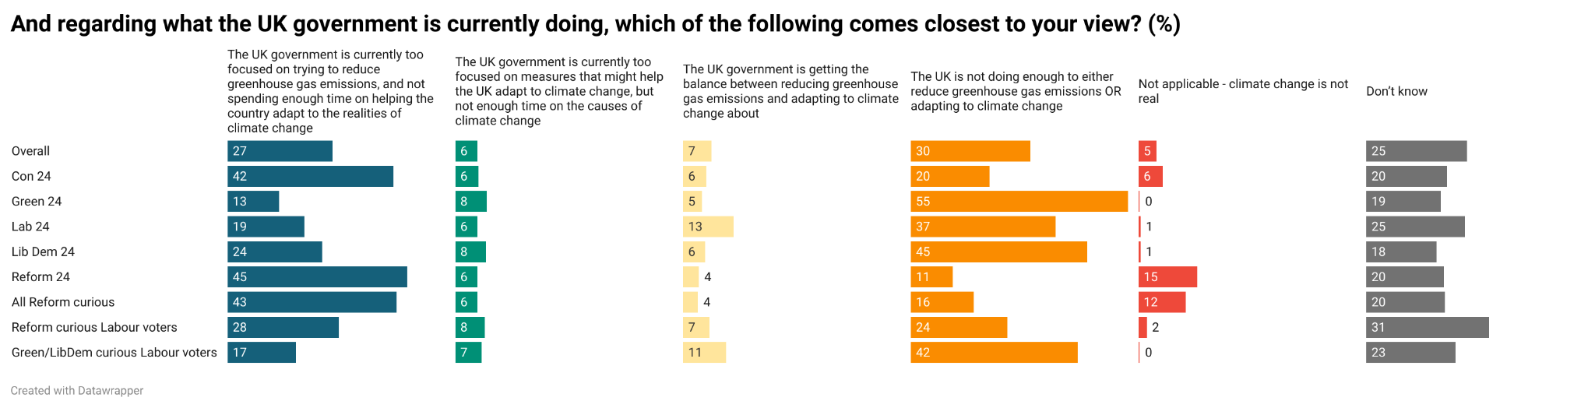

Slide 17
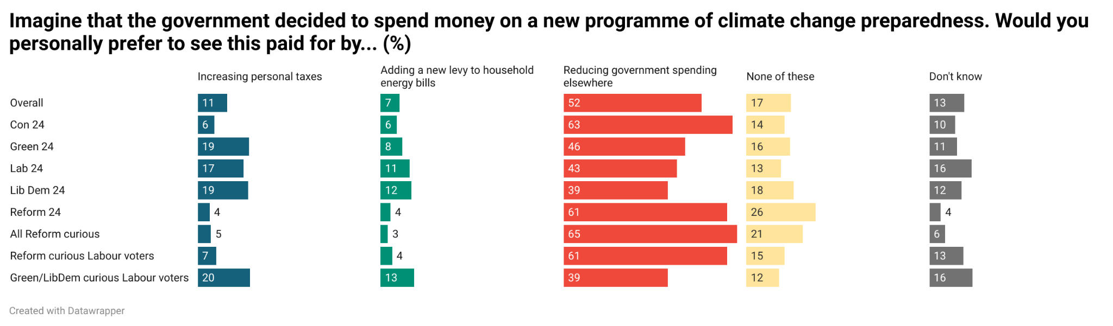

Slide 18
On solutions
Nature based solutions appear to be the most popular across the UK electorate.
It’s possible this is just because opinion in this area is fairly soft and people like ‘nice things’ - nature sounds like nice things.
In reality, only a handful of adaptation policies are truly unpopular - at least in principle. This is despite the fact we flagged the trade-off of each in the question wording.

Slide 19
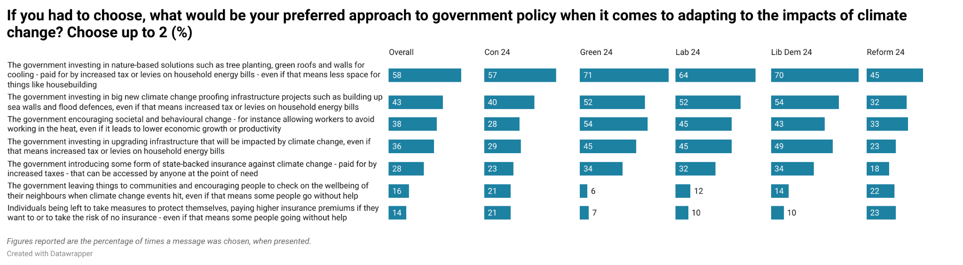

Slide 20
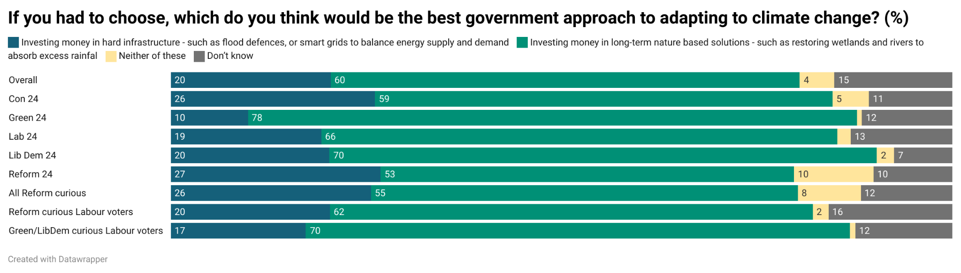

Slide 21
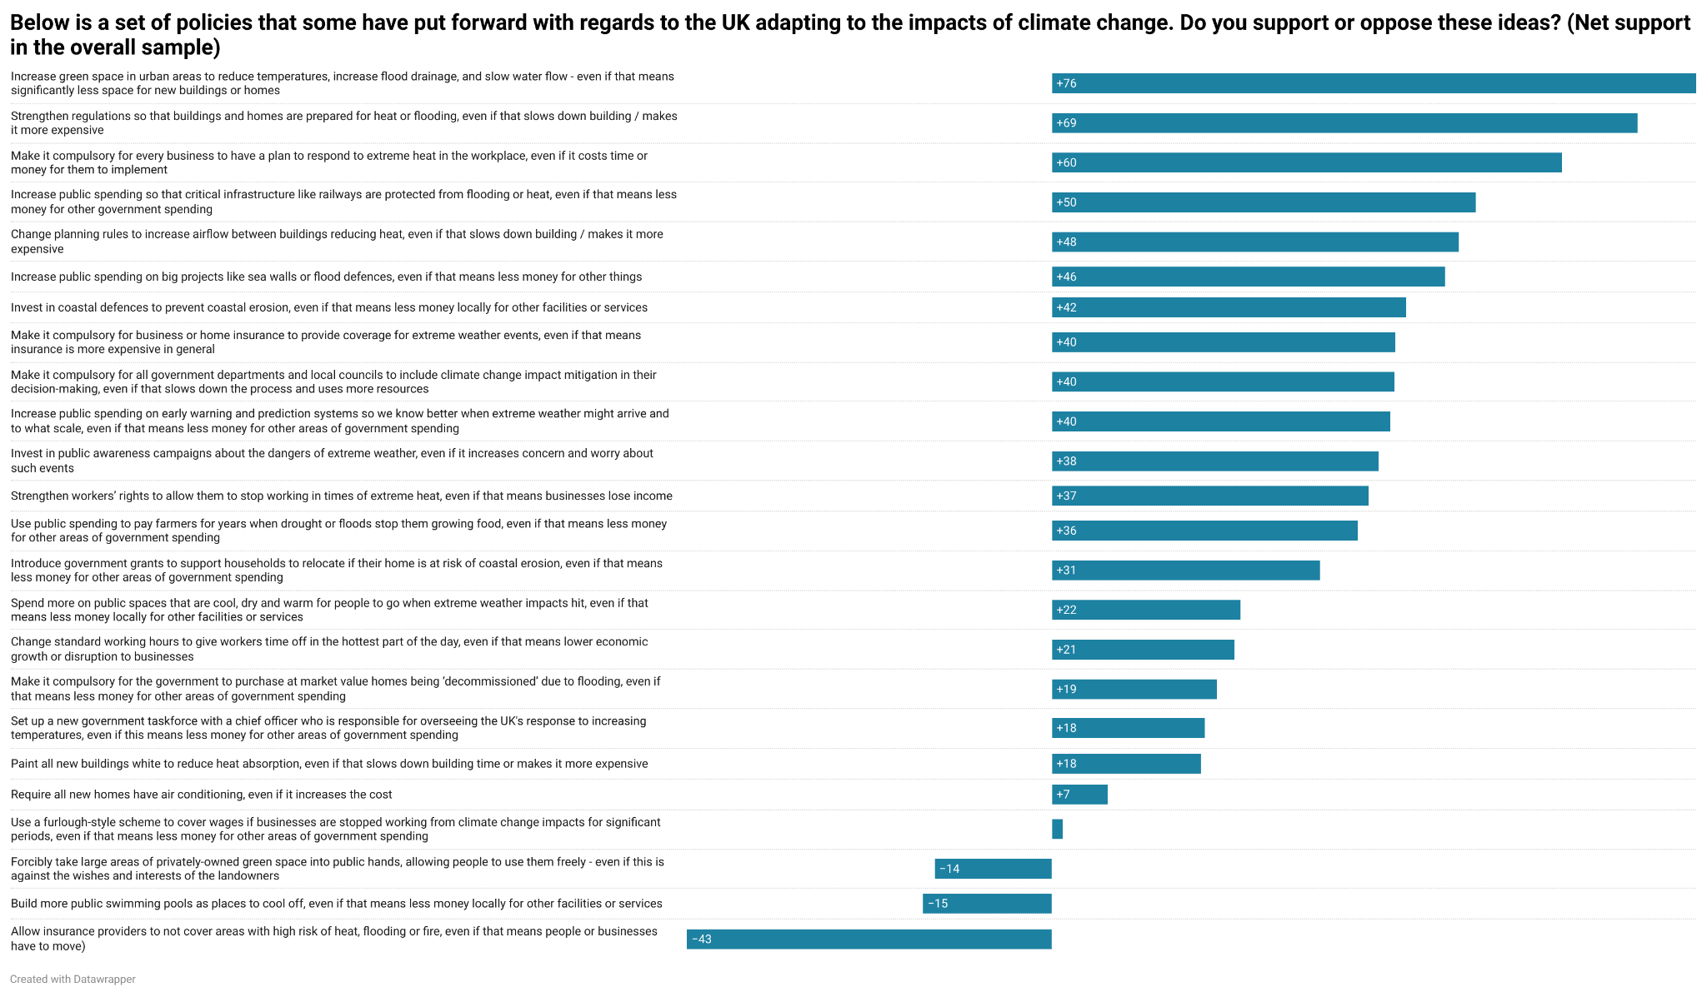

Slide 22
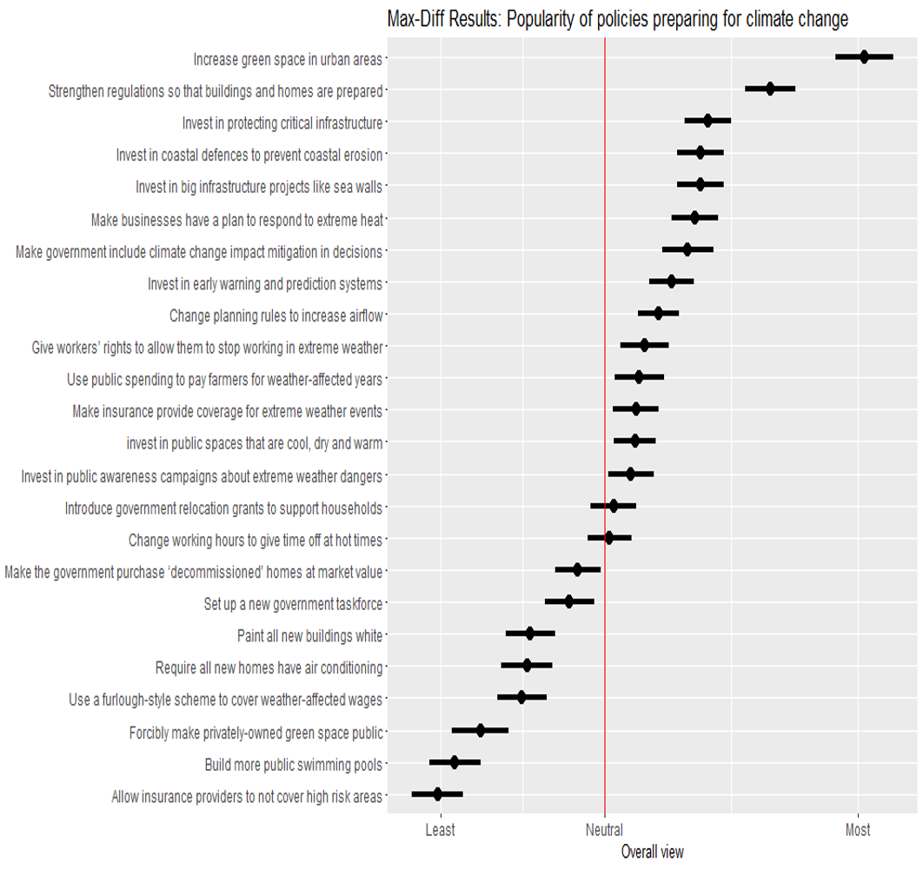

Slide 23
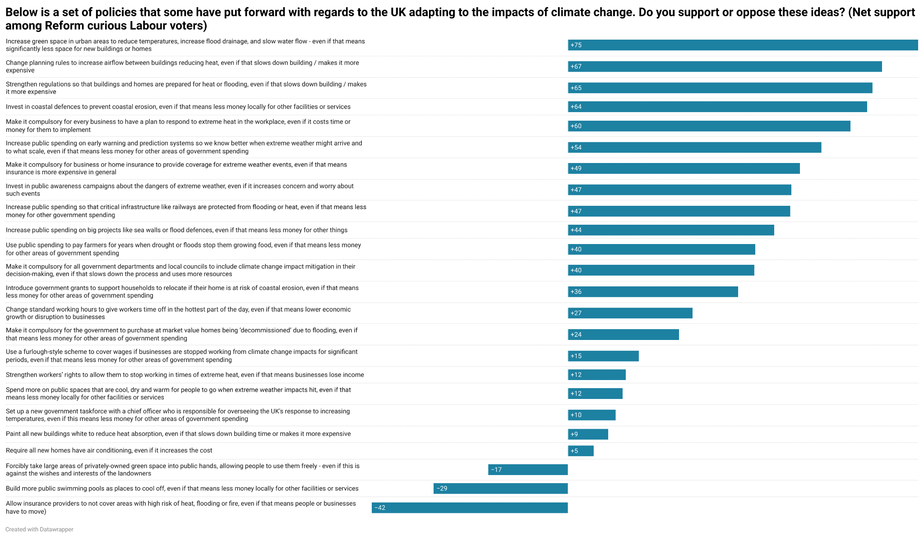

Slide 24
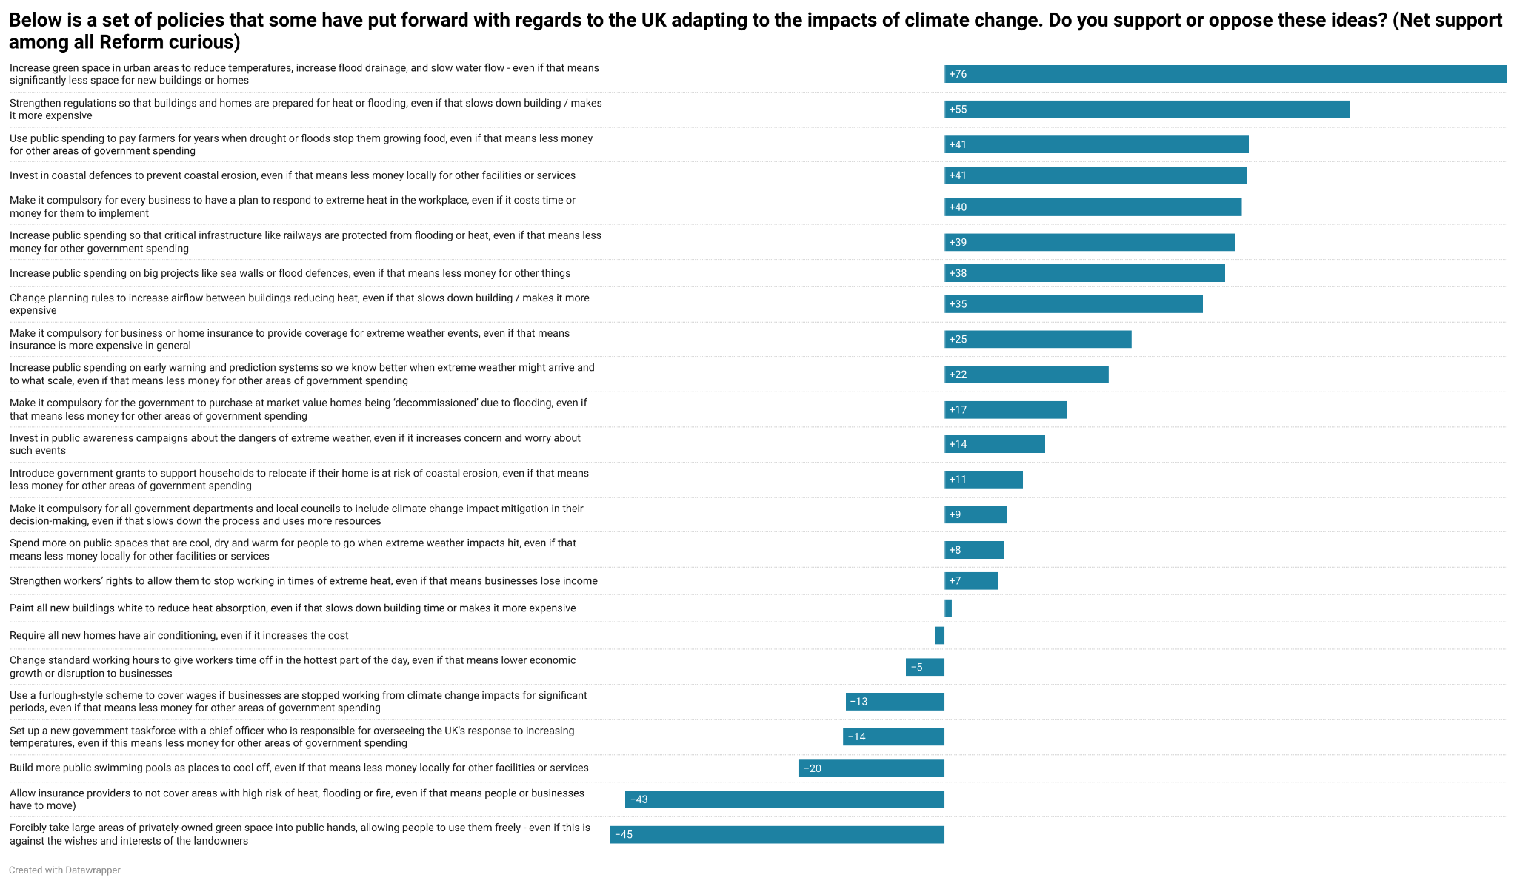

Slide 25
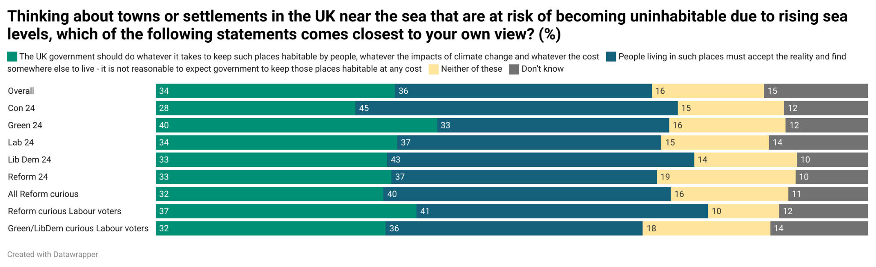

Slide 26
On communication
Preparedness or adaptation is probably the best phrase for what we’re describing here
If you’re trying to raise climate salience overall, ‘Climate impacts’ or ‘national security’ messaging works best.
For raising sympathy to the overall mission, ‘Insurance and prudency’ messaging works best.

Slide 27
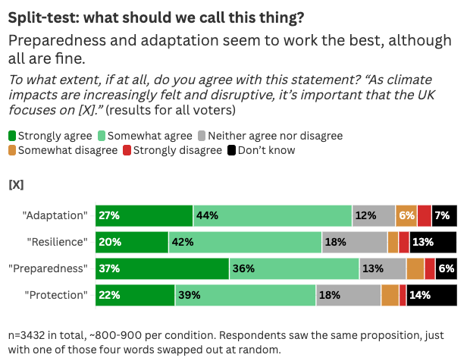

Slide 28
RCT experiment

Slide 29
Treatment 1 - Climate impacts
Below is an argument some people are making about the need to prepare for climate change.
--
Extreme weather events are hitting more frequently and more severely than before as global temperatures continue to rise. There are more days of extreme heat now, with each hot day hotter than before, and droughts lasting longer. Flooding is more frequent and more damaging as higher amounts of rainfall fall in shorter periods. Ocean storms are hitting the country more often than before. We’re even seeing forest fires in the UK become a yearly event. The science tells us that both the increasing severity and frequency of these events is driven by climate change.
It’s vital we adapt now to limit the impact of these climate driven events.

Slide 30
Treatment 2 - Adaptation and Mitigation
Below is an argument some people are making about the need to prepare for climate change
--
Climate change is having real effects on the UK. Flooding, extreme heat, drought, and stormy conditions are all getting more severe and frequent. We need to both make these events less frequent and reduce their impact when they inevitably do hit.
That means we need to reduce the UK’s emissions to limit the global warming that’s driving climate change while also adapting to the climate change that emissions have already caused. We will have to live with some climate impacts, but every small improvement we make makes them less likely and less dangerous.
Both are going to be essential, doing one without the other is only half of what’s required.

Slide 31
Treatment 3 - Local resilience
Below is an argument some people are making about the need to prepare for climate change.
--
Climate change is having real impacts on local communities and how we live our lives. Flooding is putting local football pitches and small businesses like pubs underwater. Extreme heat is piling pressure on local hospitals and care homes that are already under strain. Farmers are finding it harder to grow local produce with successive seasons of drought and flooding.
We need to help communities prepare for a world in which climate impacts are getting worse and more frequent, helping households and local businesses be better prepared. This will mean adapting local services and community infrastructure to better withstand floods, heat or storms.

Slide 32
Treatment 4 - National security
Below is an argument some people are making about the need to prepare for climate change.
--
Climate change is making flooding, extreme heat, forest fires and dangerous storms more frequent and more severe. This poses a risk to our way of life and our national security.
Top military leaders have said that the impacts of climate change are core to national security in the modern world. It threatens our critical infrastructure, saps away the resources the government and our armed forces use to protect ourselves, and accelerates threats from overseas, for example more unstable regions.
We need to act at home to better protect our country from the impacts of climate change, building new, stronger infrastructure that can keep the lights on when disaster strikes, or helping farmers continue to grow food here to boost our food security. We must adapt now to maintain our way of life.

Slide 33
Treatment 5 - Insurance and prudency
Below is an argument some people are making about the need to prepare for climate change.
--
Climate change is making flooding, extreme heat or dangerous fires and storms more frequent and severe. This is having real impacts on businesses and our economy.
When businesses are struck by extreme weather events, it can be very costly for them and for the public finances to recover. Flooding can damage buildings or other assets, extreme heat can mean staff are off work sick for long periods. These costly and uncertain impacts are holding back businesses from growing or hiring more people.
Because we know that extreme events will be more frequent and severe, it makes financial sense to spend more now on insuring ourselves against climate impacts - saving money in the long run. Prudent business and government will mean investing in better protection, like flood defences or air conditioning to ensure the show stays on the road when floods or heat do strike.

Slide 34
Treatment 6 - Co-benefits
Below is an argument some people are making about the need to prepare for climate change.
--
Climate change is making flooding, extreme heat, dangerous fires and storms more frequent and severe. We are going to have to adapt to reduce the impact of these events but as we do we can improve the country at the same time.
But this can also be an opportunity to improve things. Schools and hospitals that are prepared for extreme heat are cooler and more comfortable, and less likely to get damp or mould. More green space to limit flooding also makes air less polluted for local residents.
Adapting to climate change is important, but it also presents an opportunity to make practical improvements to local communities.

Slide 35
Control
[NO MESSAGE]

Slide 36
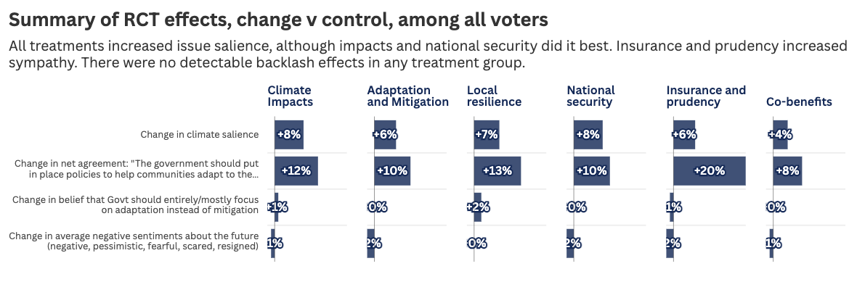

Slide 37
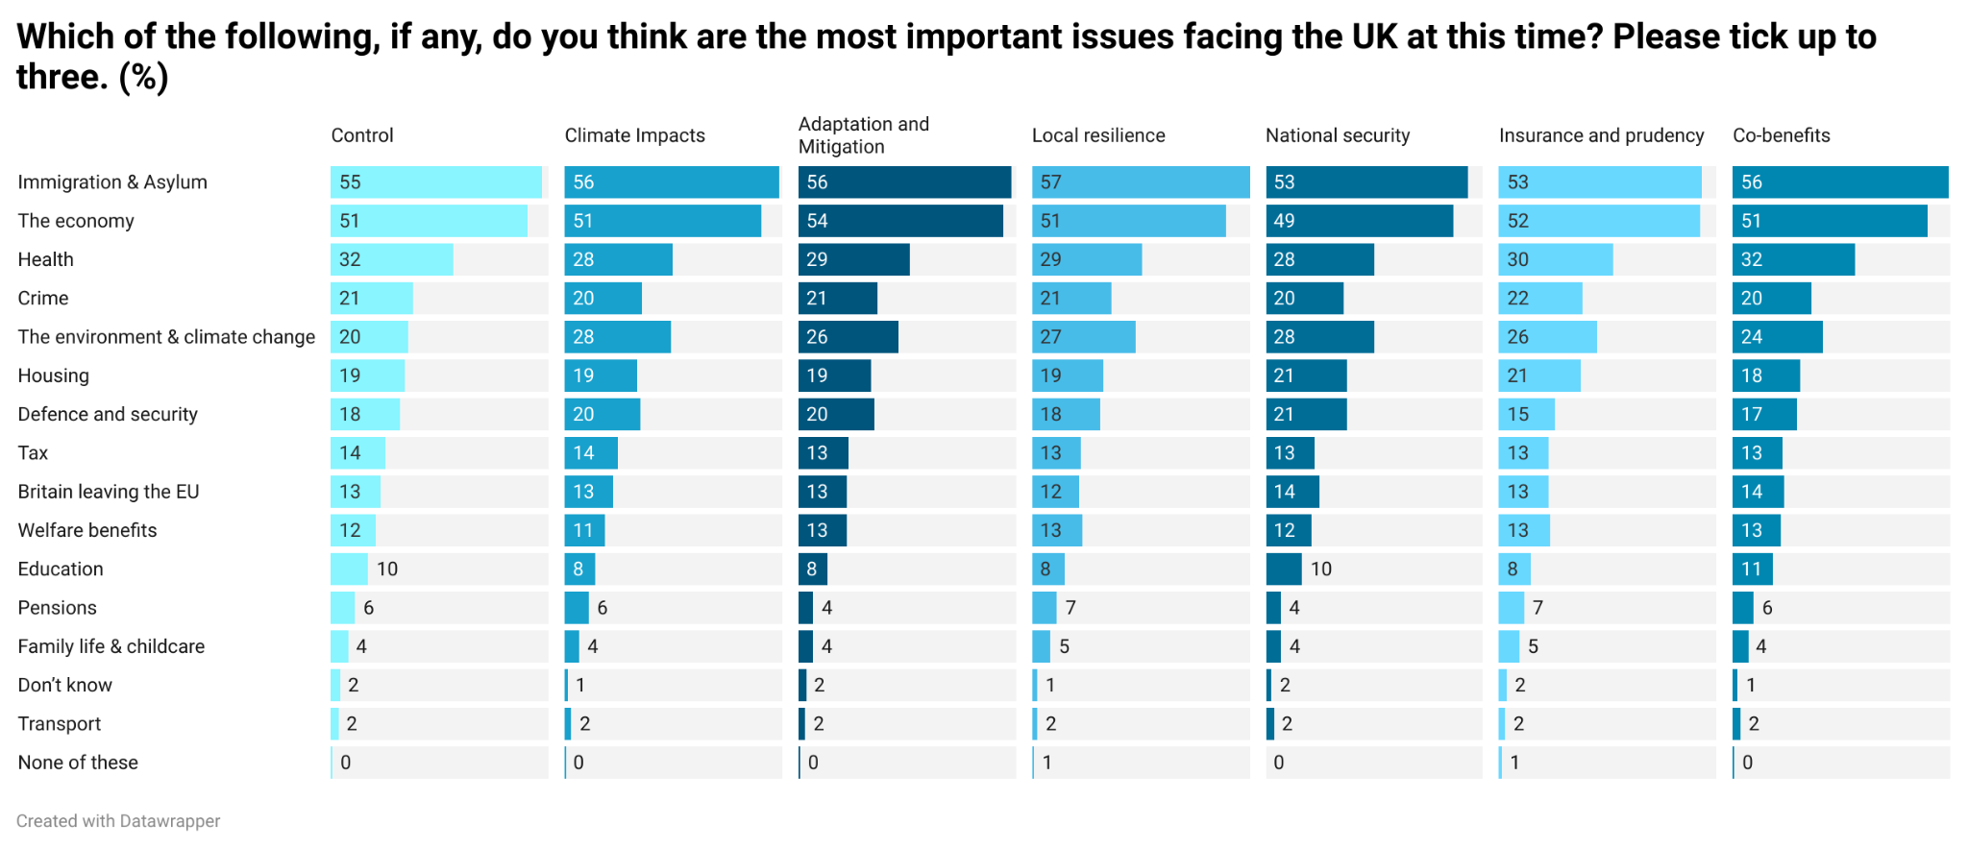

Slide 38
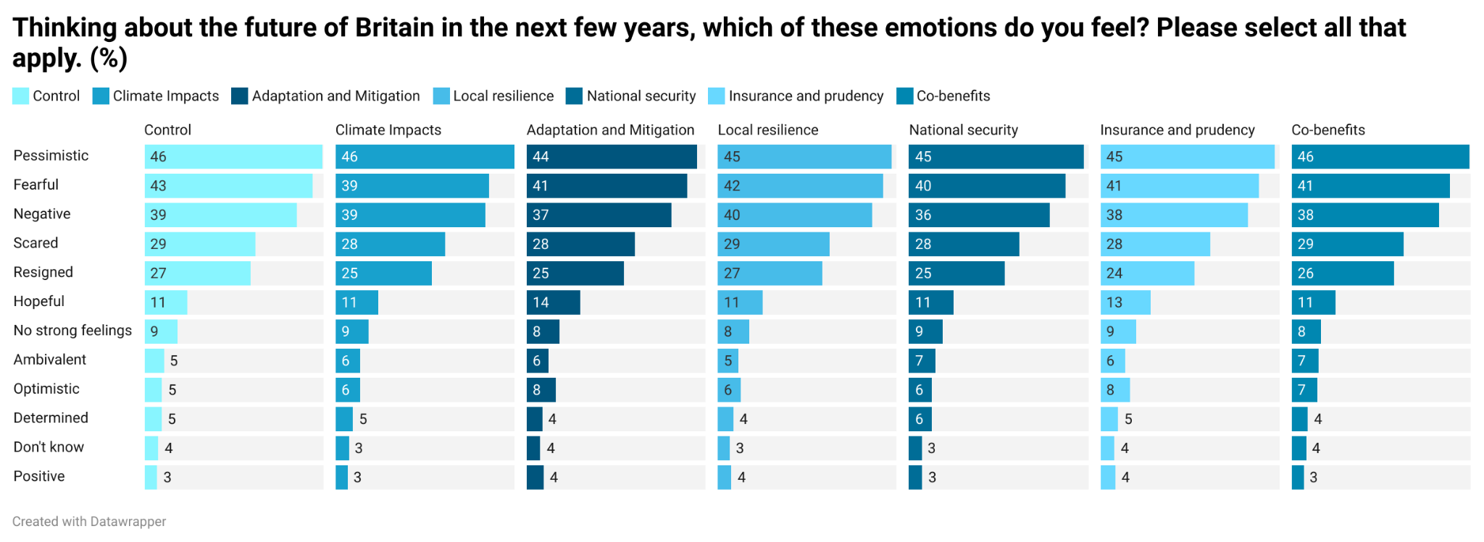

Slide 39
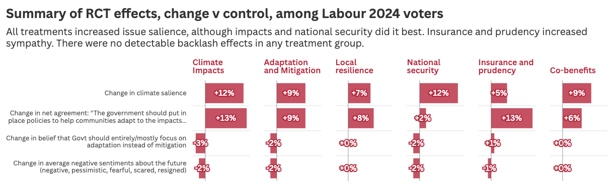

Slide 40
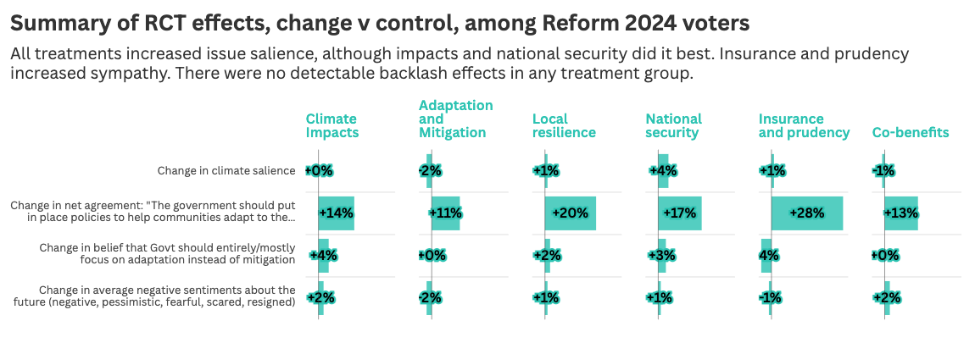

Slide 41
Conclusions

Slide 42
Most voters understand the threat of climate change - and feel the UK is poorly placed to deal with it.
However, most people - including Lab/Reform swing voters - do not instinctively buy the trade-off between adaptation and mitigation. They want both.
  The view that the UK government is doing too much emissions reduction and not enough adaptation is also held by no more than 27% of the population. This doesn’t change much when exposed to adaptation messages.
  This is another area where a small, vocal and highly online minority of core Reform voters has been allowed to distort perceptions of public opinion.
Overall, the risk around not investing in adaptation is a risk to government competence more than Net Zero - and should be taken seriously in those terms. Right now it’s just not a very polarised space, although that doesn’t mean it can’t become one, so the time to get ahead of it is now.

Slide 43
Nature based solutions appear to be the most popular across the UK electorate.
  It’s possible this is just because opinion in this area is fairly soft and people like ‘nice things’ - nature sounds like nice things.
  In reality, only a handful of adaptation policies are truly unpopular - at least in principle. This is despite the fact we flagged the trade-off of each in the question.
Preparedness or adaptation is probably the best phrase for what we’re describing here
If you’re trying to raise climate salience overall, ‘Climate impacts’ or ‘national security’ messaging works best. For raising sympathy to the overall mission, ‘Insurance and prudency’ messaging works best.

Slide 44
Thanks!
*Please do help us share this research with anyone you think would be interested*
@SteveAkehurst
https://persuasionuk.org/

